Slide 1
HR Analytics: Job Change of Data Scientists
Nosky, Christopher
DSC530

Slide 2
Hypothesis
Does Education or Experience play a greater role in decision to leave?
Does Length of time at current job impact this decision?
Is current company size or company type a factor?

Slide 3
Abstract
  I first became interested in this topic from a general perspective as I entered my first management role. I was entered into a Leadership training course and I remember one of the first questions asked being “What are the top 5 reasons people give for leaving a company?” The idea was to ask this question at the start of the training and again afterwards to see if the answers had changed (which of course they did). Some of the reasons surprised me, some not so much, but from then on it has always been a topic that holds my interest. As I was looking for a dataset to use for this project, this one certainly stood out as one that could satisfy both my longtime interest and that could be relevant to why we are here.

Slide 4
The Data
Initially this dataset started with 13 variables, primarily categorical. The variables I intend to use are:
relevent_experience
education_level
major_discipline
experience
company_size
company_type
last_new_job

Slide 5
What the variables look like.
relevent_experience – This was a binary variable ‘Has relevant experience’ and ‘No relevant experience’
Education_level – This variable had four options ‘High School’, ‘Graduate’, ‘Masters’ and ‘Phd’
Major_discipline – Included Arts, Business, Humanities, No Major, Other and STEM
Experience – experience in years ranging from less than 1 year to more than 20 years
Company_size – Divided into 8 groups of less than 10 to greater than 10000
Company_type – Divided into groups PVT ltd, startup, public sector, early stage startup, other
Last_new_job – indicates last new job respondent started ranging from 1 year to 4+ years

Slide 6
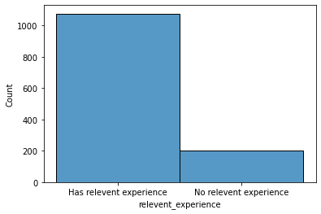
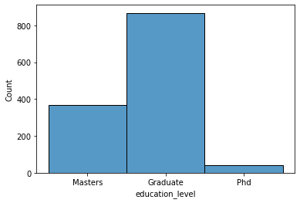
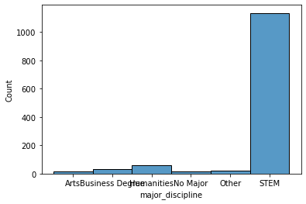
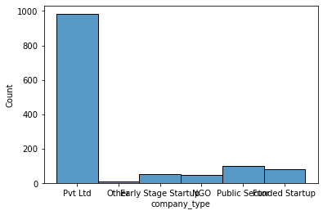
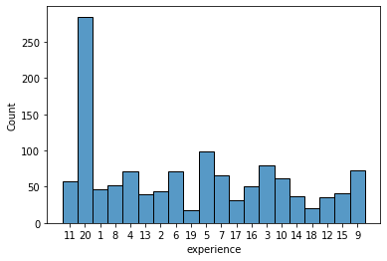
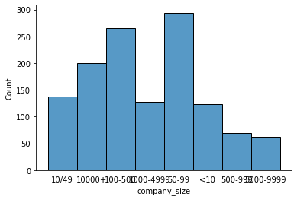
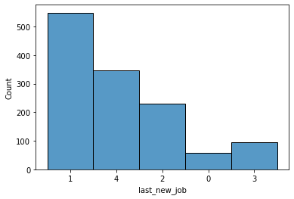
Histograms
These histograms represent each of the variables used here after cleaning the data.

Slide 7
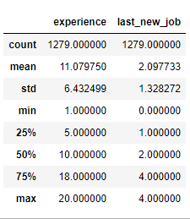
Descriptive Statistics
Using the describe() function I was able to get the mean, standard deviation, quartiles and min/max values of the two numeric variables.

Slide 8
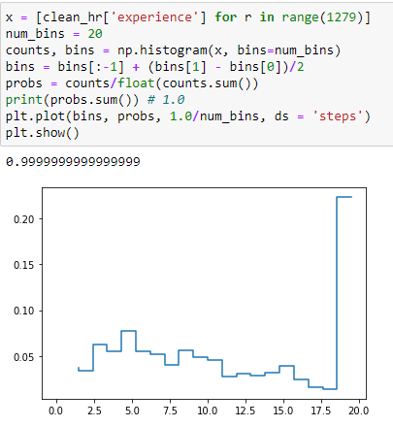
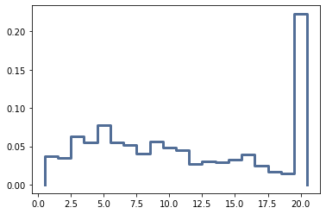
PMF’s
Interesting note, as I was working on generating the PMF, rather than using the thinkstats2 code I attempted to build my own and got similar but not the same results but could not figure out how to get the exact result as seen in the first graphic.
This second graphic is using the thinkstats2 code.

Slide 9
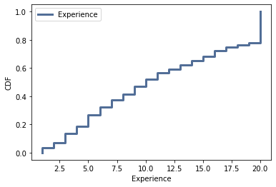
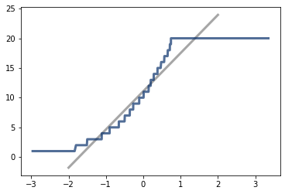
CDF & Q-Q plot
Looking at this cdf and Thinkstats my interpretation would be that this represents the general shape of an exponential distribution.
With this Q-Q plot I might say that the model curve matches the model near the mean but deviates at the tails.

Slide 10
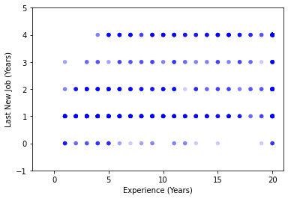
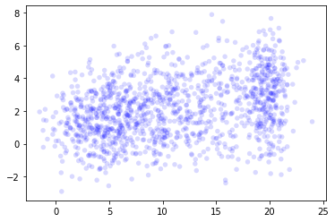
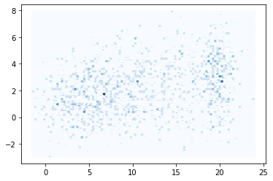
Scatter Plots
In this first graphic, I’ve plotted the two variables experience and last_new_job. Looking at this plot, it’s hard to really see the shape of the distribution.
Here I’ve added a jitter to the values to spread out the data. Just by looking at this plot you can start to see a couple clusters around the 5- & 20-year experience levels. (more on this later)
This third plot is a hexbin plot, it looks very similar to the effect we see in the scatter plot with jittering.

Slide 11
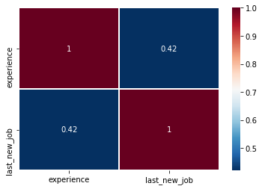

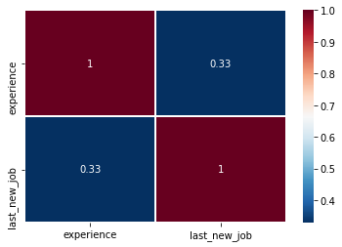
Correlation Heatmaps
Next here are some correlation heatmaps for Pearson, Spearman and Kendall methods and we can see that there is some correlation between our experience and last_new_job variables.

Slide 12
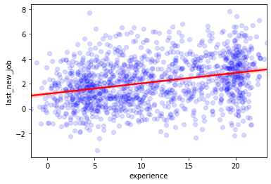
Regression
At this point I’ve calculated the values for R-squared, the Intercept and Slope which I was able to plot.
This is the same scatter plot we saw earlier with the jitter added.

Slide 13
Questions?

